Slide 1
Life below Zero
Bank Lending Under Negative Policy Rates
Florian Heider, Farzad Saidi, and Glenn Schepens
Yuwen Wang

Slide 2

C
ONTENTS
Introduction/Venation
Results
0
1
0
3
Model set up
Conclusion/Discussion
0
2
0
4

Slide 3
Part one
Introduction & Venation of research

Slide 4
background
On June 5, 2014, the ECB (European Central Bank) Governing Council lowered the deposit facility (DF) rate to - 0.10%. Shortly after, on September 4, 2014, the DF rate was lowered again to -0.20%.
The setting of negative rates in mid-2014 was seen as a bold and controversial move. Especially the cut in September came as a surprise. Since then, the ECB has lowered the DF rate two more times, on December 9, 2015, to -0.30%, and on March 6, 2016, to -0.40%.

Slide 5

The typical view
There is special role for bank deposits.
Banks should generally lend more when the policy rate decreases. A lower (positive) policy rate lowers banks’ cost of funding, and thereby increases bank net worth. More net worth, in turn, reduces banks’ external-finance premium, allowing banks to expand lending.
When the policy rate decreases, banks with higher net worth have more “skin-in-the-game” (or, equivalently, a higher franchise value) and should take less risk.

Slide 6

However……
After the cutting down of deposit facility rate, banks with more deposits concentrate their lending on riskier firms in the market for syndicated loans. A one-standard-deviation increase in banks’ deposit ratio leads to the financing of firms with at least 16% higher return-on-assets volatility and to a reduction in lending of at least 13%.
Why?

Slide 7
The authors introduced a new effect that kicks in when the policy rate becomes negative. When the policy rate becomes negative, greater reliance on deposits (relative to market-based debt) has an adverse effect on bank net worth. This adverse effect on bank net worth explains why banks with more deposits should lend less and take more risk once the policy rate becomes negative.

Slide 8
How does it works
Deposit funding hurts bank net worth because the lower negative policy rate does not transmit to lower negative deposit rates, while it does transmit to lower negative market rates.
Normally, lower positive policy rates transmit to lower rates on both deposits and market-based debt. We show this is no longer the case for deposit rates once the ECB sets negative rates. Hence, banks relying more on deposit funding relative to market-based funding experience a lower reduction in their cost of funding, which adversely affects their net worth.
Negative policy rates do not transmit to lower deposit rates because banks appear reluctant to charge negative rates to their depositors. As soon as deposits offer a negative nominal return, they become inferior to cash, which offers a zero nominal return, and depositors withdraw. Fearing deposit withdrawals, banks do not lower deposit rates to below zero。

Slide 9

Based on this logic, the authors examine the transmission of negative policy rates to the supply of bank credit using a difference-in-differences approach. They compare the lending behavior of banks with different deposit ratios before and after the ECB sets negative policy rates in mid-2014. The identifying assumption therefore is that the lending behavior of low-deposit banks provides the counterfactual for the lending behavior of high-deposit banks in the absence of a negative policy rate.

Slide 10
Mean threats
the control group(low-deposit bank) may be inappropriate
Maybe the observation is just a hitherto unknown role of bank deposits for the general transmission of policy rates.
selection of firms and banks into lending relationships according to banks’ deposit ratio
This applies when there is a difference between high-deposit and low- deposit banks that changes when the policy rate becomes negative. Such a time-varying difference violates the parallel-trends assumption, which is key to the identification of a causal effect in a difference-in-differences setup.

Slide 11
Exploit the granularity of our transaction-level data on syndicated loans, and compare the lending behavior of high-deposit and low-deposit banks to the same borrower. Including firm-time fixed effects eliminates any time-varying difference in lending opportunities (e.g., loan demand) between high-deposit and low-deposit banks.
Mean threats
the control group(low-deposit bank) may be inappropriate
selection of firms and banks into lending relationships according to banks’ deposit ratio
Use confidential supervisory information to compare banks with a lot of household deposits to those with few household deposits.
Because it is easier for households than for corporates to withdraw their deposits, banks should be more reluctant to charge negative rates on household rather than corporate deposits.
Also limits the scope for other coincidental events driving our findings

Slide 12
Expanding sample and including multiple policy-rate changes, independent of their size, timing, or whether they are cuts or increases.
banks’ deposit ratio does not matter for the pass-through of non-negative rates to banks’ risk taking and lending volume. Instead, the transmission of policy rates to the supply of bank credit via deposits occurs only when policy rates become negative.
01
Are negative policy rates indeed special ?
02
Assessing the external validity of the findings. While syndicated loans account for a sizable portion of total bank lending, they do not necessarily capture overall bank lending behavior.
High-deposit banks exhibit higher stock-return volatility and a stronger increase in their credit-default-swap spreads when the policy rate becomes negative, attesting to their risk taking.
While overall bank lending increases after the setting of negative policy rates, the lending of high-deposit banks increases less than the lending of low-deposit banks.
Maybe we just identify a hitherto unknown role of bank deposits for the general transmission of policy rates?

Slide 13
Contributions of the analyze
The first paper to examine empirically how negative policy rates transmit to the real economy
Contribute to an emerging literature on the role of deposit financing for bank behavior
Extend the literature on the bank lending channel, i.e., how policy-rate changes impact the supply of bank credit
Extend the understanding of the bank risk-taking channel and link it to the literature on the bank lending channel.
Contribute to the recent literature assessing the impact of non-standard monetary- policy measures, where existing work mainly focuses on the impact of asset-purchase pro- grams and extraordinary liquidity provision.

Slide 14
Part Two
Model Set up

Slide 15
The aim of the model is to test the following hypothesis: negative policy rates lead to greater risk taking and less lending by banks with more deposit funding.
A difference-in-differences strategy, which is implement by comparing the lending behavior of euro-area banks with different deposit ratios around the ECB’s introduction of negative policy rates in June 2014, is used to test the hypothesis.
The analyze of banks’ lending behavior is based on the syndicated-loan market.

Slide 16
baseline specification
Equation 3
1
3
2
4
Equation 2
Equation 4

Slide 17
The baseline specification.
y_{ijt} is an outcome variable reflecting, for instance, a firm/loan characteristic such as
firm risk or loan terms associated with firm i’s loan provided by loan syndicate j at time t.
Deposit ratio_{j} is equal to the 2013 deposit ratio of the euro-area lead arranger in syndicate j when there is only one lead arranger. (When there are multiple lead arrangers, equal to the average deposit ratio)
After(06/2014)t is a dummy variable for the period from June 2014 onwards
X_{ijt} denotes firm-level and syndicate-level control variables
δ_{t} denotes time fixed effects
η_{j} is a bank fixed effect in syndicates with only one lead arranger. When there are multiple lead arrangers, η_{j} denotes a vector of bank fixed effects containing one fixed effect for each lead arranger in syndicate j.

Slide 18
The baseline specification.
The key identifying assumption is that conditional on bank and time fixed effects, as well as potential control variables X_{ijt}, low-deposit banks provide the counterfactual for the lending behavior of high-deposit banks in the absence of a negative policy rate. In that case, the estimate of β in regression gives the causal impact of the negative policy rate on the supply of bank credit via banks’ cost of funding.

Slide 19
The main threat to the identifying assumption are time-varying differences across high- deposit and low-deposit banks. Such time-varying differences put the lending behavior of high-deposit and low-deposit banks on different trends, which cannot be differenced out.
1
2
3
4
examine whether the deposits-to-assets ratio changes differently across high-deposit and low-deposit banks, either in response to or in anticipation of the negative policy rate
vary the set of control variables _{Xijt}, which essentially refines the comparison of our treatment group (high-deposit banks) and our control group (low-deposit banks)
exploit the structure of syndicated loans, and explain the loan shares retained by high-deposit and low-deposit banks.
Modify measure of banks’ exposure to the setting of negative policy rates in order to limit the possibility that some confound affects the lending of high-deposit and low-deposit banks differently (HH vs NFC)

Slide 20
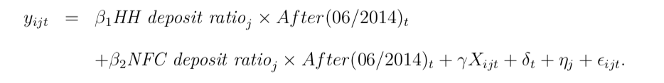
Equation 2
Modify the measure of banks’ exposure to the setting of negative policy rates in order to limit the possibility that some confound affects the lending of high-deposit and low-deposit banks differently. Instead of the ratio of overall deposits to total assets, consider household (HH) and non-financial-corporation (NFC) deposits over total assets, and estimate the following regression specification
What about negative policy rates?

Slide 21
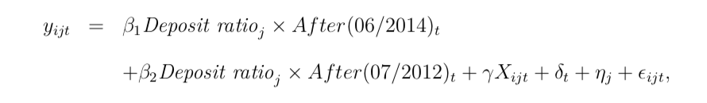
Equation 3
After(07/2012)_{t} is a dummy variable for the period from July 2012 onwards.
In July 2012, the ECB cut the DF rate from 0.25% to zero. If negative rates are special, then we expect the estimate of β2 to be insignificant and the estimate of β1 to be similar to the estimate of β from the baseline. If, however, there was nothing special about negative policy rates, then the estimate of β2 (as well as of β1) would pick up a general role of deposits for the effect of policy-rate cuts on the supply of bank credit.

Slide 22
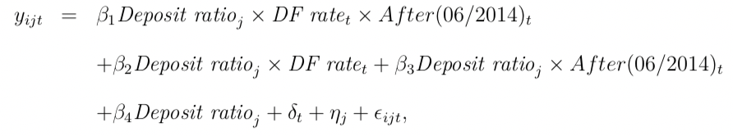
Equation 4
A useful placebo test in the following sense. Suppose it is not the difference in the deposits-to-assets ratio across banks that drives lending behavior but the difference in some other bank characteristic. If that other characteristic exposes banks differently to policy-rate cuts in general, then one should observe a significant estimate of β2.
To extend our test of whether negative policy rates are special, we estimate the following generalization of equation 3:
DF rate_{t} is the ECB’s deposit facility rate at the monthly level.
Allows to examine changes in the policy rate more generally, independent of their size, timing, or whether they are cuts or increases. We extend our sample to the

Slide 23
Part Three
Results

Slide 24

Results
measure of banks’ ex-ante risk taking
impact of negative policy rates on the volume of bank lending
firm-time fixed effects
Part four

Slide 25
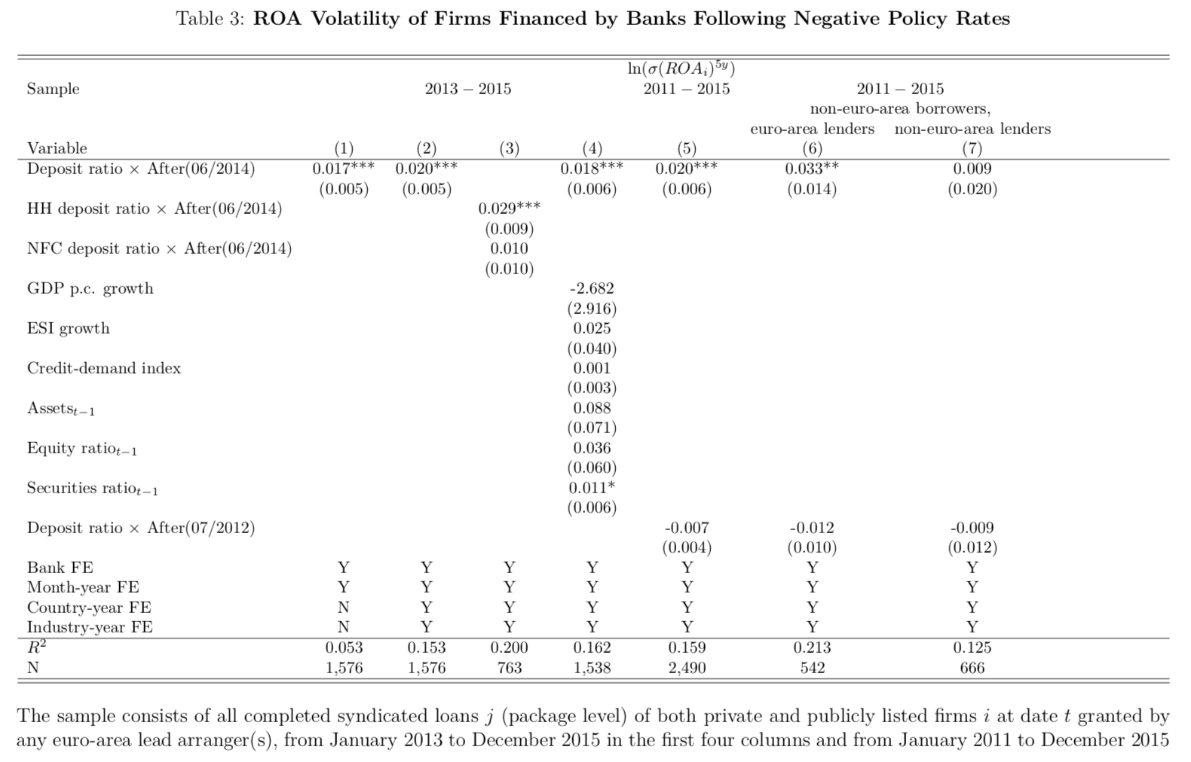
Results - measure of banks’ ex-ante risk taking
The first two columns present the results from estimating equation (1) when the dependent variable y_{ijt} is a measure of banks’ ex-ante risk taking. The baseline measure of ex-ante risk taking is σ(ROA_{i})^{5y}, the five-year standard deviation of loan-financed firm i’s return on assets (ROA, using profit & loss before tax) from year t − 5 to t − 1.

Slide 26
banks’ ex-ante risk taking – baseline equation
The first column shows the basic difference-in-differences specification with bank and month-year fixed effects only. Can find a positive and significant treatment effect. Banks with more deposits finance riskier firms when rates become negative.
Significance: a one-standard-deviation increase in Deposit ratio (= 9.45 percentage points) translates into a 16% increase in ROA volatility (9.45 × 0.017 = 0.161)

Slide 27
banks’ ex-ante risk taking – baseline equation
In the second column, add fixed effects to control for borrower characteristics. By removing unobserved time-varying country and industry factors of borrowers, we increase the difference-in-differences estimate from 0.017 to 0.020.
One possible concern is that the introduction of negative policy rates in June 2014 coincides with other events that might affect the risk taking of banks. As long as other coincidental events affect high-deposit and low-deposit banks in the same way, these other concurrent policy measures are differenced out.

Slide 28
banks’ ex-ante risk taking – equation 2
To rule out such confounds more formally, estimate equation (2), using confidential data from the Single Supervisory Mechanism (SSM). In The third column, compare banks with different exposure to negative rates according to whether their deposits are held by households or by non-financial corporations. Because of the harder zero lower bound on household deposits, we expect a stronger effect for banks with more household deposits than for banks with more corporate deposits.
In contrast, neither the LCR nor the TLTROs should affect household and corporate deposits differently. As hypothesized, the difference- in-differences estimate is much more precisely estimated, and also larger in size, for banks that rely more on household deposits.

Slide 29
banks’ ex-ante risk taking – equation 2
In column 4, add control variables to refine the comparison of high-deposit and low-deposit banks.
Three time-varying variables at the level of the banks’ country of origin to control for lenders’ local economic conditions.
In particular, use quarter-on-quarter growth rates in GDP per capita and the European Sentiment Indicator (ESI) as well as an index based on the country-level answers to the question on loan demand from the ECB’s Bank Lending Survey
In addition, we control for banks’ size, their equity ratio, and their securities ratio.
Adding all of these control variables leaves the difference-in-differences estimate virtually unchanged.

Slide 30
banks’ ex-ante risk taking – equation 3
Column 5 shows the results from estimating equation (3), which tests whether the transmission of the negative rate cut via deposits is special. We apply the same difference- in-differences approach also to the rate cut in July 2012, when the ECB lowers the DF rate from 0.25% to zero. The estimate of β2, the coefficient on the interaction Deposit ratio × After(07/2012), is insignificant, while the estimate of β1, the coefficient on the interaction Deposit ratio × After(06/2014), is unchanged. Different deposit ratios expose banks differently to lower, negative rates but not to lower, non-negative rates.

Slide 31
banks’ ex-ante risk taking – borrowers
Column 6 reduce the sample to European borrowers outside the euro area. The majority of these firms (70%) are UK firms. The loan demand of these non-euro- area firms should be less affected by economic conditions and policies in the euro area. The coefficient on our treatment Deposit ratio × After(06/2014) is stronger, while the coefficient on Deposit ratio × After(07/2012) remains insignificant. This suggests that our results are unlikely to be driven by monetary policy reacting to the economic condition of firms or by monetary policy affecting loan demand.

Slide 32

banks’ ex-ante risk taking – borrowers
Column 7 performs a falsification test using non-euro-area lenders to non-euro-area borrowers.
we expect to find no effect of setting negative policy rates on the risk taking of those banks. In line with this reasoning, the coefficient on the treatment Deposit ratio × After(06/2014) is insignificant.

Slide 33
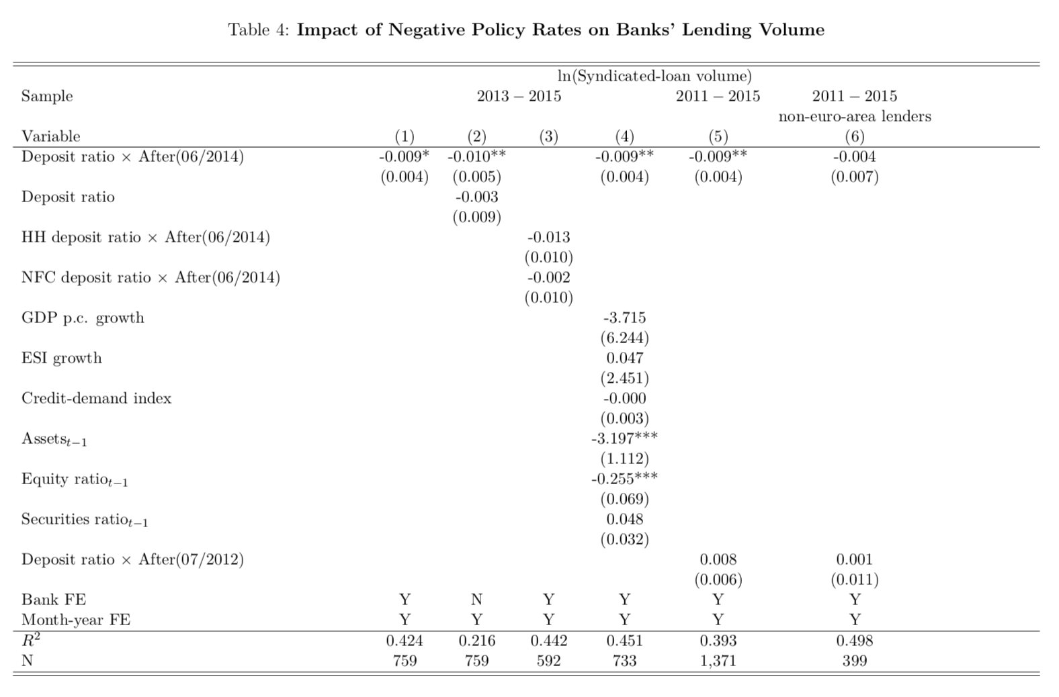
impact of negative policy rates on the volume of bank lending
The first column of Table 4 presents the basic difference-in-differences specification with bank and month-year fixed effects.
In the second column, replace the bank fixed effects with the actual deposit ratio for robustness. The estimate of the coefficient on Deposit ratio × After(06/2014) is negative and significant (at the 5% level in column 2 and at the 10% level in column 1). In column 3, estimate equation (2). The difference-in-differences estimate is more than six times larger (in absolute terms) for banks relying on household deposits, on which they are more reluctant to charge negative rates.
In column 4, add the same controls for local economic conditions and bank characteristics as in column 4 of Table 3.

Slide 34
impact of negative policy rates on the volume of bank lending
In column 5, also add the placebo treatment in July 2012 (equation (3) at the bank level). Doing so leaves the difference-in-differences estimate unaltered, while the coefficient on the placebo treatment remains insignificant. As before, adding control variables does not increase the explanatory power much relative to our baseline with bank and time fixed effects.

Slide 35
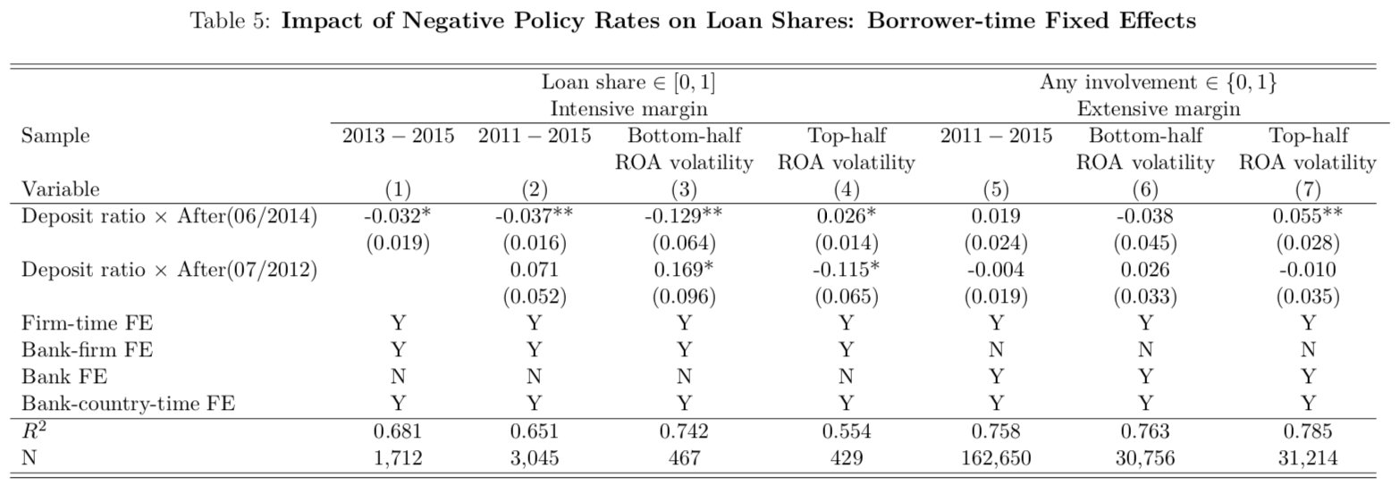
firm-time fixed effects
The comparison the lending behavior of high-deposit and low-deposit banks to the same borrower, rule out the concern that high-deposit and low-deposit banks face different investment opportunities (e.g., different loan demand) after the setting of negative policy rates.

Slide 36
Part Four
Conclusion & Discussion

Slide 37
Conclusion
When central banks charge negative policy rates, they enter unchartered territory. The results suggest potential costs of negative policy rates in terms of limited stimulus and financial instability. Normally, one views high-deposit banks as traditional intermediaries providing most of the lending and being most stable. Negative policy rates have the potential to change the role of these banks for the supply of credit to the real economy.

Slide 38
Discussion
Merits
Further considerations
The essay discussed how negative policy rates affect the supply of bank credit in a novel way. It is the first paper to examine empirically how negative policy rates transmit to the real economy, and examined the possible bias with convincing data and regression methods
One may consider the following questions after reading the essay:
Time horizon: compare June , 2014 – December, 2015 to 2011 - 2014, relatively short period, and past may not predict future
Consequence of deposit facility rate cut-down may differ in different economy environments ( e.g. Japan)
Does the cut-down only have negative impact on economy?
(example of krone)

Slide 39
Thank You !

